Slide 1
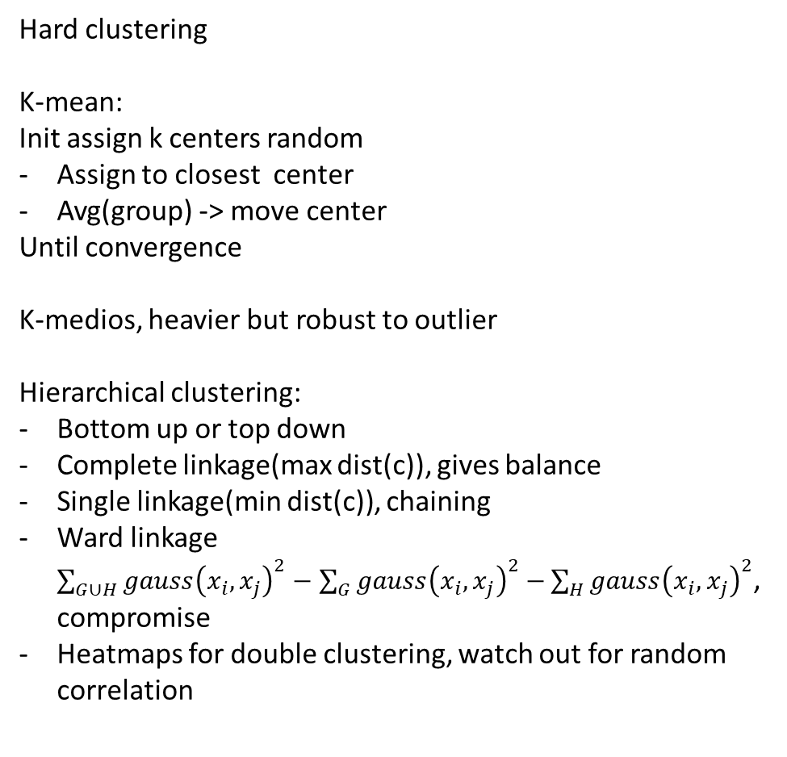
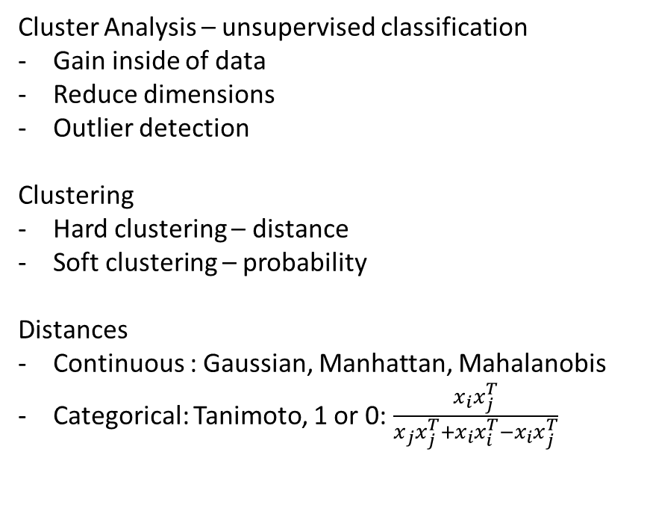
Lecture 9
Cluster Analysis – unsupervised classification
Gain inside of data
Reduce dimensions
Outlier detection
Clustering
Hard clustering – distance
Soft clustering – probability
Distances
Continuous : Gaussian, Manhattan, Mahalanobis
Categorical: Tanimoto, 1 or 0: $\frac{x_{i}x_{j}^{T}}{x_{j}x_{j}^{T}+x_{i}x_{i}^{T}−x_{i}x_{j}^{T}}$
Hard clustering
K-mean:
Init assign k centers random
Assign to closest center
Avg(group) -> move center
Until convergence
K-medios, heavier but robust to outlier
Hierarchical clustering:
Bottom up or top down
Complete linkage(max dist(c)), gives balance
Single linkage(min dist(c)), chaining
Ward linkage $\sum_{G∪H}{gauss{\left(x_{i},x_{j}\right)}^{2}−\sum_{G}{gauss{\left(x_{i},x_{j}\right)}^{2}−}\sum_{H}{gauss{\left(x_{i},x_{j}\right)}^{2}}}$, compromise
Heatmaps for double clustering, watch out for random correlation

Slide 2
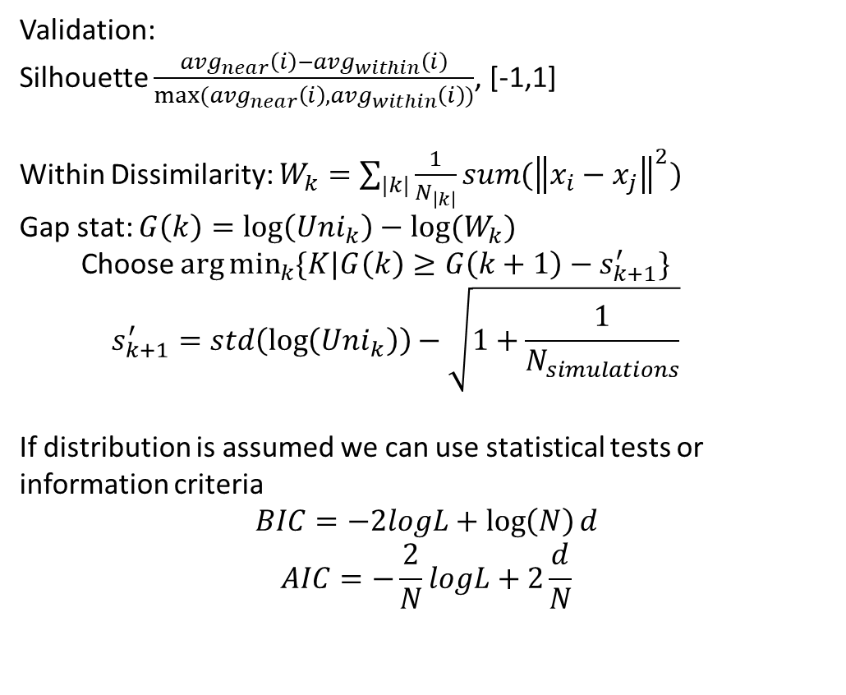
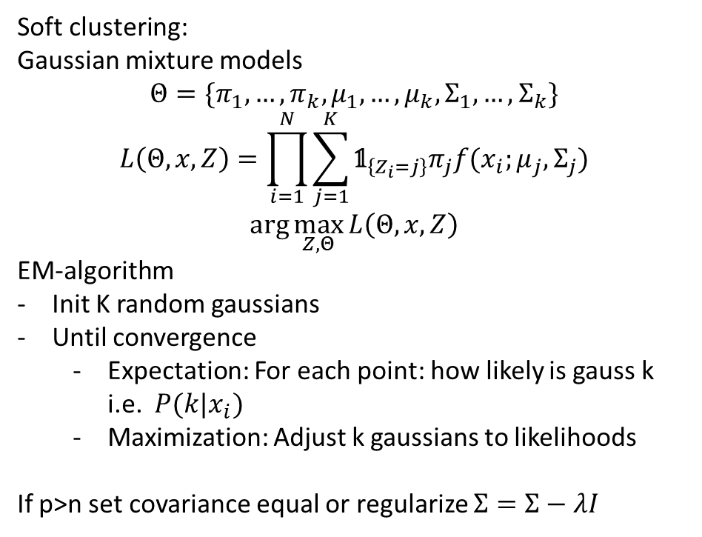
Lecture 9
Soft clustering:
Gaussian mixture models
$$Θ=\{π_{1},…,π_{k},μ_{1},…,μ_{k},Σ_{1},…,Σ_{k}\}$$
$$L\left(Θ,x,Z\right)=\prod_{i=1}^{N}{\sum_{j=1}^{K}{{\text{𝟙}}_{\left\{Z_{i}=j\right\}}π_{j}f(x_{i};μ_{j},Σ_{j})}}$$
$$\arg{\max_{Z,Θ}{L\left(Θ,x,Z\right)}}$$
EM-algorithm
Init K random gaussians
Until convergence
Expectation: For each point: how likely is gauss k i.e. $P(k|x_{i})$
Maximization: Adjust k gaussians to likelihoods
If p>n set covariance equal or regularize $Σ=Σ−λI$
Validation:
Silhouette $\frac{avg_{near}\left(i\right)−avg_{within}\left(i\right)}{max⁡(avg_{near}\left(i\right),avg_{within}\left(i\right))}$, [-1,1]
Within Dissimilarity: $W_{k}=\sum_{|k|}{\frac{1}{N_{\left|k\right|}}sum({\left\|x_{i}−x_{j}\right\|}^{2})}$
Gap stat: $G\left(k\right)=\log\left(Uni_{k}\right)−log⁡(W_{k})$
Choose $\arg{\min_{k}{\{K|G\left(k\right)≥G\left(k+1\right)−s_{k+1}^{′}\}}}$
$$s_{k+1}^{′}=std\left(\log\left(Uni_{k}\right)\right)−\sqrt{1+\frac{1}{N_{simulations}}}$$
If distribution is assumed we can use statistical tests or information criteria
$$BIC=−2logL+\log\left(N\right)d$$
$$AIC=−\frac{2}{N}logL+2\frac{d}{N}$$

